Slide 1
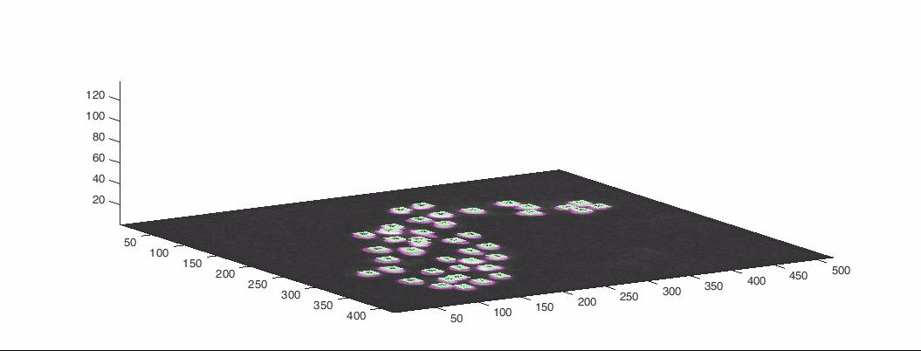
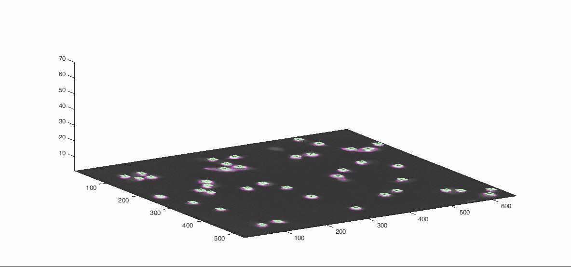
Analysis of High-throughput Microscopy Videos: Catching Up with Cell Dynamics
Tammy Riklin Raviv
Assaf Arbelle, Topaz Gilad
Electrical and Computer Engineering
Ben-Gurion University of the Negev

Slide 2
Collaborators
Anne Carpenter, The Broad Institute
Mark Bray, The Broad Institute
Uri Alon, The Weizmann Institute
Nir Drayman, The Weizmann Institute
Galit Lahav, Harvard Medical School
Jia-Yun Chen, Harvard Medical School
Jose Lopez Reyes, Harvard Medical School

Slide 3
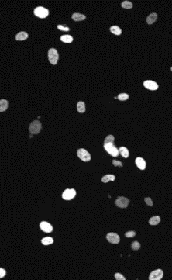

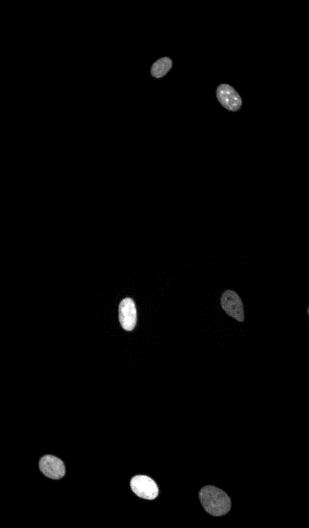
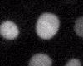
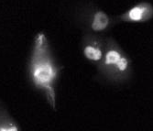
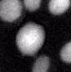
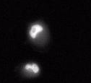
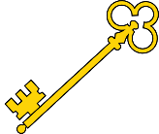
Challenges
Various Data Sets
Rapidly Moving Cells
Cell Properties:
Lahav Lab
Mitosis
Overlapping Tracks
Shape Variation
Unclear Boundaries
Size
Location
Velocity
Intensity
Lineage
Key Elements
Segmentation
Association
Burgge Lab
Alon Labs
Burgge Lab
Alon Lab

Slide 4
Related Work
Microscopy Video Analysis
Active Contour Methods
Dzyubachyk et al. - Advanced level-set-based cell tracking in time-lapse fluorescence microscopy. MedIA, 2010.
Padfield et al. - Spatio-temporal cell segmentation and tracking for automated screening. ISBI, 2008.
Independent Segmentation and Tracking
Kanade et al. - Cell image analysis: Algorithms, system and applications. WACV, 2011
Rapoport et al. - A novel validation algorithm allows for automated cell tracking and the extraction of biologically meaningful parameters. PloS one, 2011.
Su et al. - Cell segmentation in phase contrast microscopy images via semi-supervised classification over optics-related features. MedIA, 2013.
Gaussian Mixture Model
Amat et al. - Fast, Accurate reconstruction of cell lineages from large-scale fluorescence microscopy data. Nature Methods, 2014
Graphical model
Schiegg et al. - Graphical model for joint segmentation and tracking of multiple dividing cells. Bioinformatics, 2014.
Independent Segmentation and Tracking
Joint Segmentation and Tracking
^{Microscopy Video Analysis}
Maška et al. A benchmark for comparison of cell tracking algorithms. Bioinformatics, 2014
Meijering et al. Methods for cell and particle tracking. Methods Enzymol, 2012
Graphical Model
Active Contours
Gaussian Mixture Model
Proposed Method

Slide 5
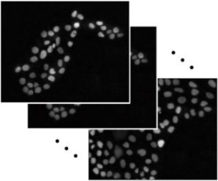
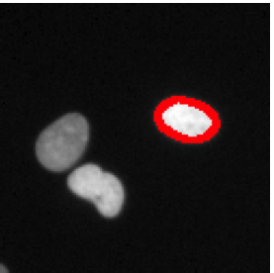
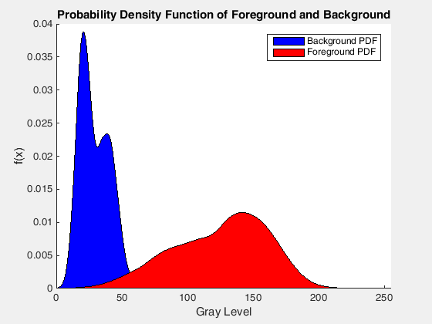
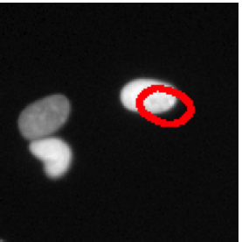
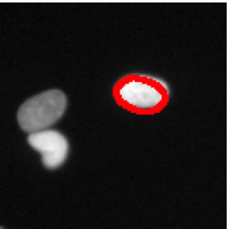

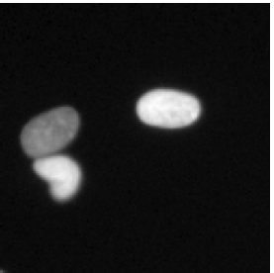
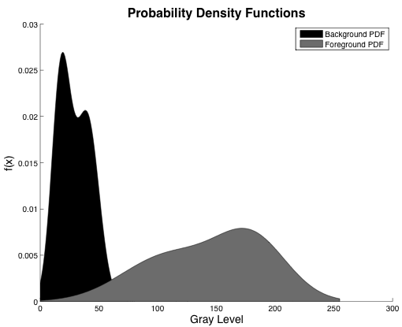
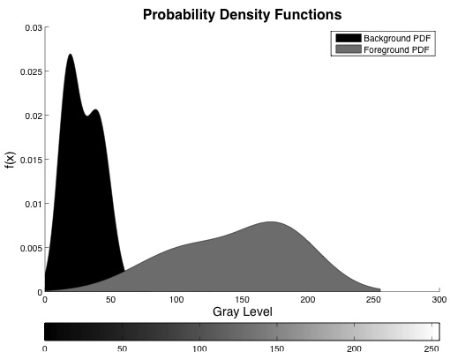
Overview
State
Calculation &
Estimation
Prior
MAP
Likelihood
t
t+1
Raw data courtesy of Lahav Lab

Slide 6
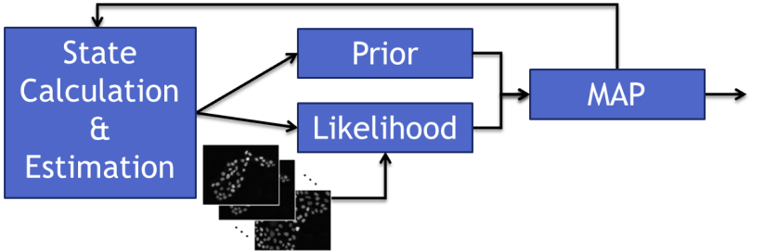
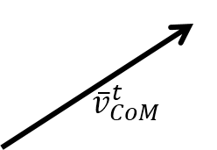




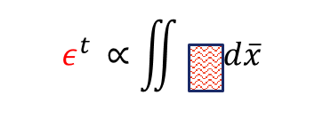
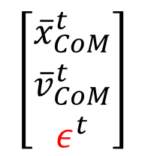
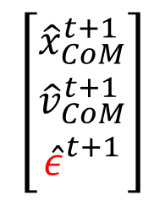
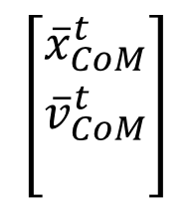
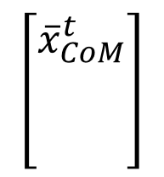


Cell Dynamics –
State Calculation and Estimation
Shape Fluctuations
Frame # t
Modified Housdorff Distance
Key Contribution #1
Frame #t-1
Measured State
Vector
Estimated State
Vector
Kalman Filter

Slide 7
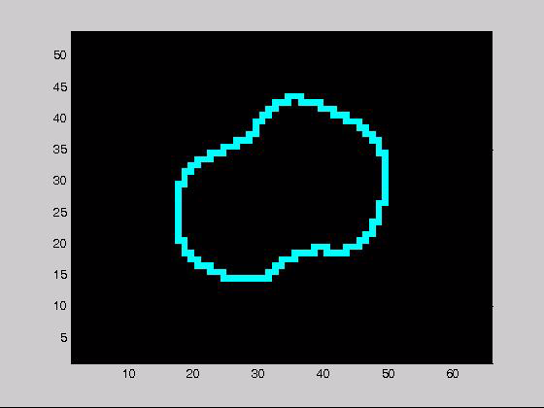
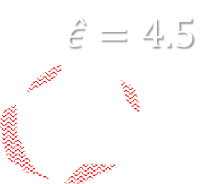
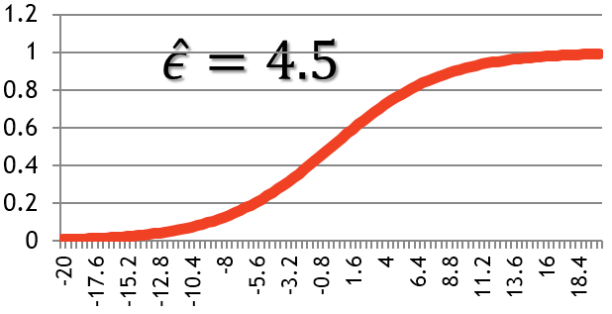
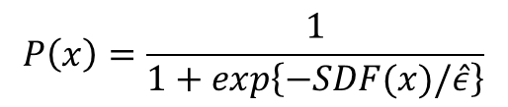
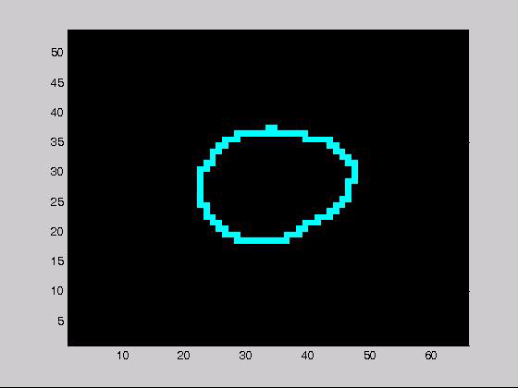
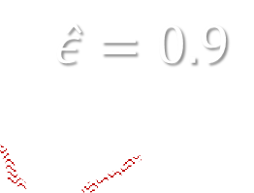
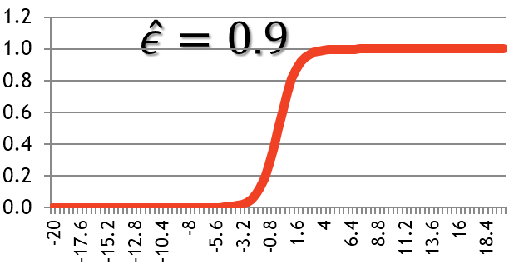
Dynamic Shape Model-
Segmentation Prior
Signed Distance to Probability
Mapping 1D
Signed Distance Function
Prior Probability Function
Aligned Contours
t-1
t
t-1
t
Raw data courtesy of Brugge Lab

Slide 8

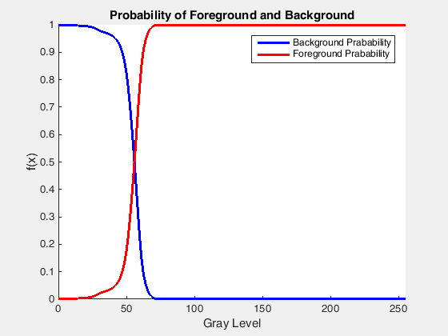



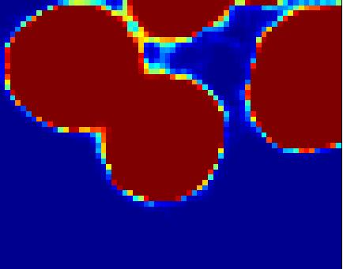
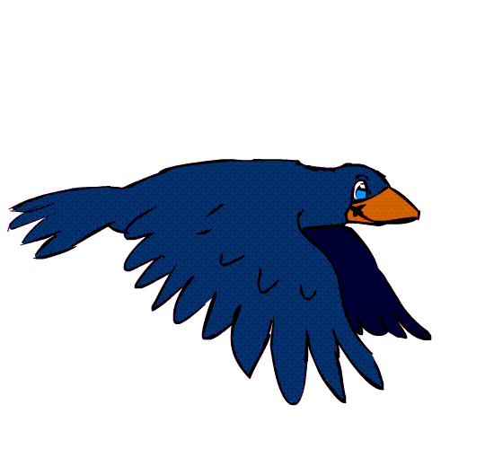

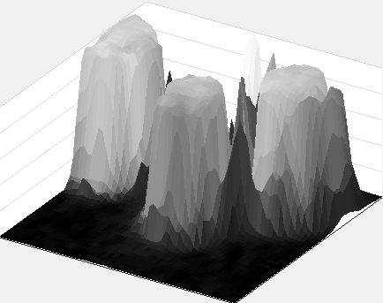
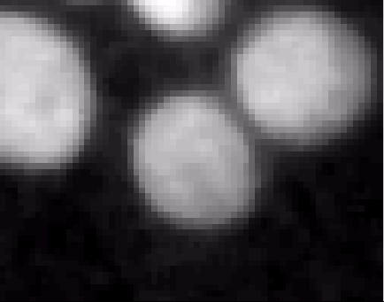


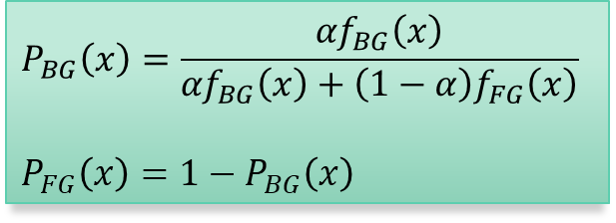
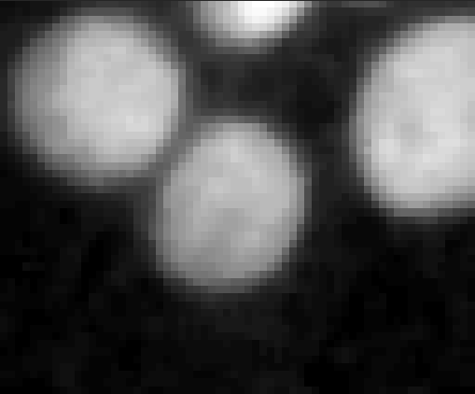
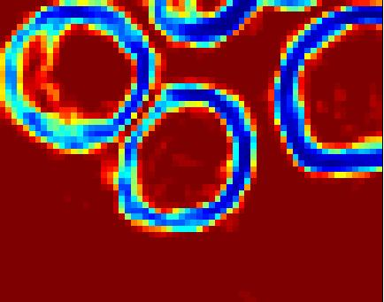
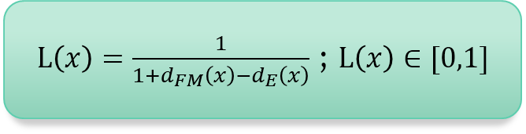
Image Likelihood
Key Contribution #2
Gray Level GMM Probabilities
(Color Coded)
Gaussian Mixture Models
Original Image
Gray Level GMM Probabilities (Mesh)
Likelihood Image (Color Coded)
Geodesic Map (Mesh)
Inverse Image Edges
(Color Coded)
Original Image
Raw data courtesy of Brugge Lab

Slide 9

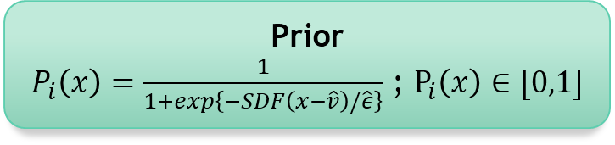
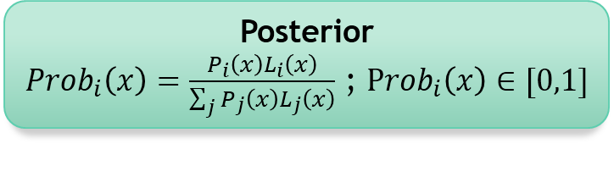
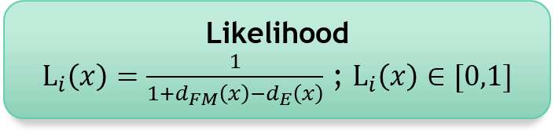
Maximum A Posteriori
Prior
Posterior
1
Likelihood
Raw data courtesy of Brugge Lab

Slide 10
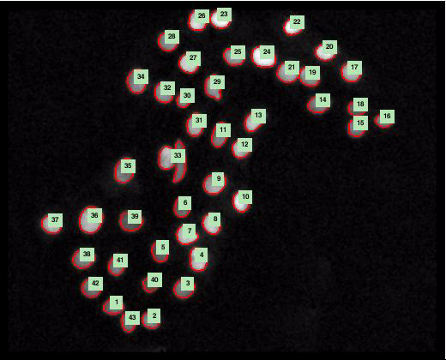
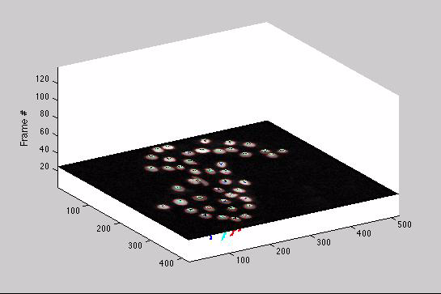
Results
Brugge Lab – Harvard
Medical School

Slide 11
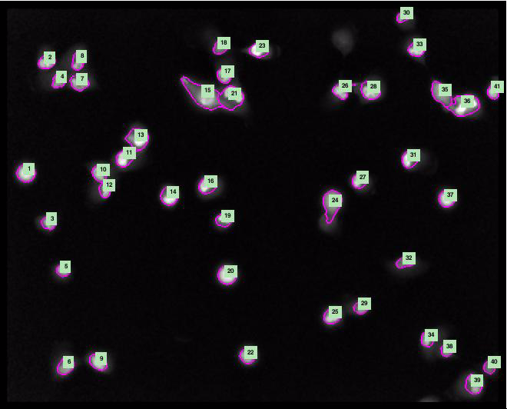
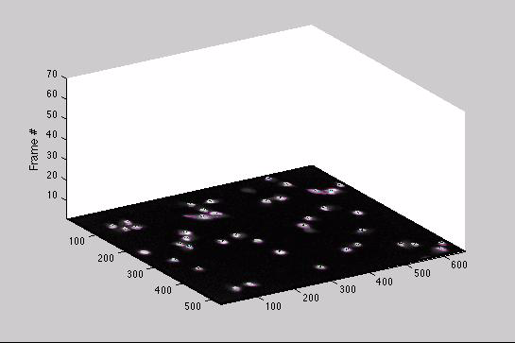
Results
Alon Lab – Weizmann
Institute of Science

Slide 12


Quantitative Results
Data | Method | Segmentation |  |  | Full Tracks | Divisions
 |  | Prc. | Rcl. | F | Success Rate | Prc. | Rcl. | F
Alon Labs | Ours | 0.98 | 0.89 | 0.93 | 0.95 | 0.84 | 0.89 | 0.86
 | Cell Profiler^{[1]} | 0.93 | 0.81 | 0.87 | 0.86 | 0.84 | 0.94 | 0.88
Brugge Labs | Ours | 1 | 0.94 | 0.97 | 0.99 | 0.96 | 0.98 | 0.97
 | Cell Profiler^{[1]} | 0.98 | 0.82 | 0.89 | 0.94 | 0.86 | 0.94 | 0.90
Auto
GT
FN
Auto
GT
TP
GT
Auto
TP
Auto
FP
[1] A.E. Carpenter et al. CellProfiler: image analysis software for identifying and quantifying cell phenotypes. Genome biology, 2006..

Slide 13
Quantitative Results
Data | Method | Segmentation |  |  | Full Tracks | Divisions
 |  | . | Rcl. | F | Success Rate | Prc. | Rcl. | F
Alon Labs | Ours | 0.98 | 0.89 | 0.93 | 0.95 | 0.84 | 0.89 | 0.86
 | Cell Profiler^{[1]} | 0.93 | 0.81 | 0.87 | 0.86 | 0.84 | 0.94 | 0.88
Brugge Labs | Ours | 1 | 0.94 | 0.97 | 0.99 | 0.96 | 0.98 | 0.97
 | Cell Profiler^{[1]} | 0.98 | 0.82 | 0.89 | 0.94 | 0.86 | 0.94 | 0.90
#1
#1
#2
#2
[1] A.E. Carpenter et al. CellProfiler: image analysis software for identifying and quantifying cell phenotypes. Genome biology, 2006..

Slide 14
Quantitative Results
Data | Method | Segmentation |  |  | Full Tracks | Divisions
 |  | . | Rcl. | F | Success Rate | Prc. | Rcl. | F
Alon Labs | Ours | 0.98 | 0.89 | 0.93 | 0.95 | 0.84 | 0.89 | 0.86
 | Cell Profiler^{[1]} | 0.93 | 0.81 | 0.87 | 0.86 | 0.84 | 0.94 | 0.88
Brugge Labs | Ours | 1 | 0.94 | 0.97 | 0.99 | 0.96 | 0.98 | 0.97
 | Cell Profiler^{[1]} | 0.98 | 0.82 | 0.89 | 0.94 | 0.86 | 0.94 | 0.90
#1
#1
#1
#2
#2
#2
[1] A.E. Carpenter et al. CellProfiler: image analysis software for identifying and quantifying cell phenotypes. Genome biology, 2006..

Slide 15
Quantitative Results
Data | Method | Segmentation |  |  | Full Tracks | Divisions
 |  | Prc. | Rcl. | F | Success Rate | Prc. | Rcl. | F
Alon Labs | Ours | 0.98 | 0.89 | 0.93 | 0.95 | 0.84 | 0.89 | 0.86
 | Cell Profiler^{[1]} | 0.93 | 0.81 | 0.87 | 0.86 | 0.84 | 0.94 | 0.88
Brugge Labs | Ours | 1 | 0.94 | 0.97 | 0.99 | 0.96 | 0.98 | 0.97
 | Cell Profiler^{[1]} | 0.98 | 0.82 | 0.89 | 0.94 | 0.86 | 0.94 | 0.90
[1] A.E. Carpenter et al. CellProfiler: image analysis software for identifying and quantifying cell phenotypes. Genome biology, 2006..

Slide 16
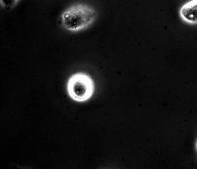
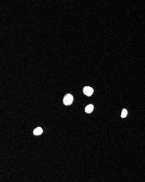
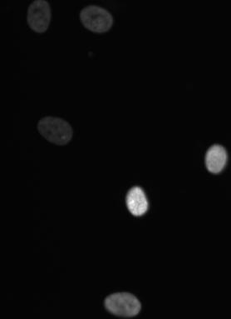



Mitosis Detection
Alon Lab
Lahav Lab
Brugge Lab

Slide 17







Using Symmetry
y
x

Slide 18


Mitosis Detection Results
N2DL-HeLa
MCF-10A

Slide 19
Summary
Objective: Cell segmentation and tracking in high-throughput microscopy videos
Observations: Segmentation and association are challenging problems when addressed separately.
Contributions:
    Formulization of the segmentation and association as a single MAP problem.
  Extension of the Kalman state vector to account for shape fluctuations.
  Definition of the Dynamic Shape Model - can be applied to any arbitrary shape.
  Incorporation of the Fast Marching distance within a generic probabilistic model
Detection of mitotic events using symmetry

Slide 20



Acknowledgements
Lahav Lab – Harvard
Medical School
RPE
Rappaport et al. –
PloS one 2011
Alon Lab – Weizmann
Institute of Science
Brugge Lab – Harvard
Medical School

Slide 21
References
A. Arbelle, N. Drayman, M. Bray, U. Alon,A. Carpenter, T. Riklin Raviv, Analysis of High-throughput Microscopy Videos:Catching Up with Cell Dynamics, Medical Image Computing and Computer-Assisted Intervention (MICCAI), pages 218--225, October 2015.
T. Gilad, M. A. Bray, A. E. Carpenter and T. Riklin Raviv,
Symmetry based mitosis detection in time-lapse microscopy, IEEE International Symposium on Biomedical Imaging: From Nano to Macro (ISBI), pages 164--167, April 2015.

Slide 22

Questions?
Notes:
Thank You,
While I’ll be taking questions I would like to show you results on three more datasets.

